Slide 1
2024/01/18 Meeting Report

Slide 2
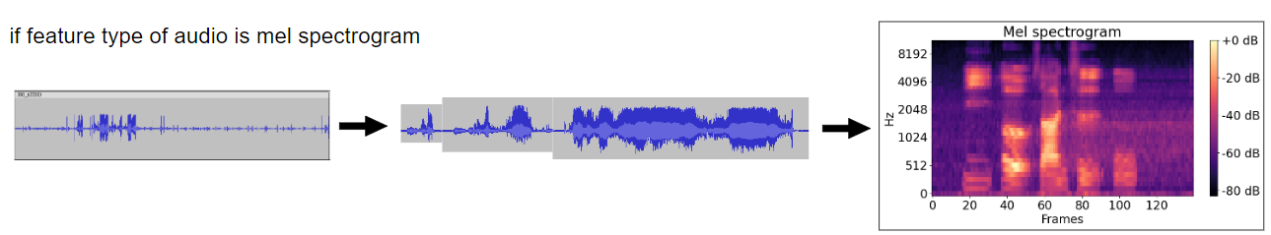
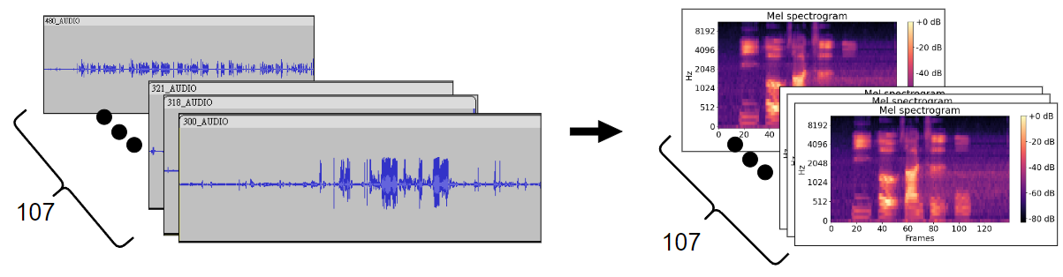
How does DepAudioNet process training data for audio file
Notes:
一般 learning rate 都會根據 batch size 做一些 scale 的操作。這裏用的是lr x batch_size / 256」。
Learning rate 小 under-fitting
Learning rate 大 unstable

Slide 3
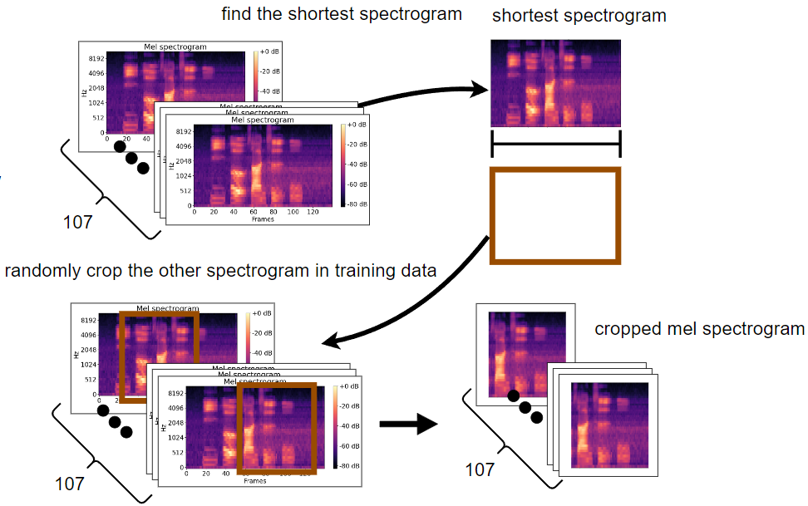
2. find the mel spectrogram in the training data which has minimum length and randomly crop the other spectrograms by its length
Notes:
一般 learning rate 都會根據 batch size 做一些 scale 的操作。這裏用的是lr x batch_size / 256」。
Learning rate 小 under-fitting
Learning rate 大 unstable

Slide 4
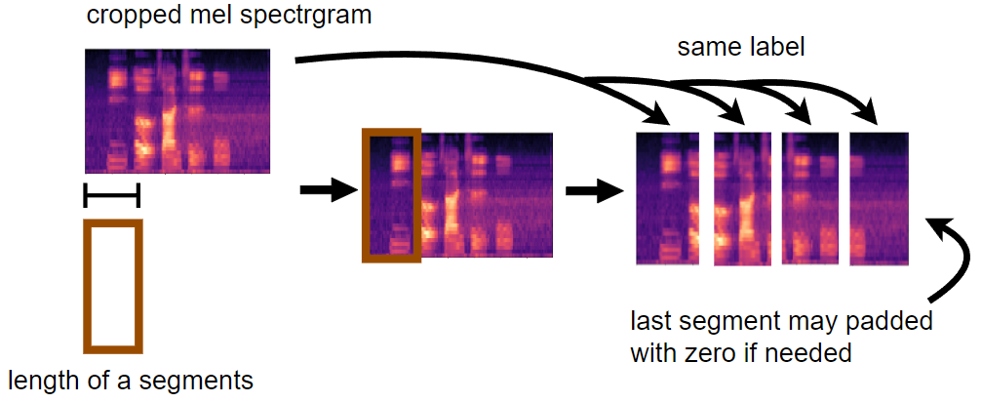
3. cut the spectrogram into multiple fixed length segments
Notes:
一般 learning rate 都會根據 batch size 做一些 scale 的操作。這裏用的是lr x batch_size / 256」。
Learning rate 小 under-fitting
Learning rate 大 unstable

Slide 5
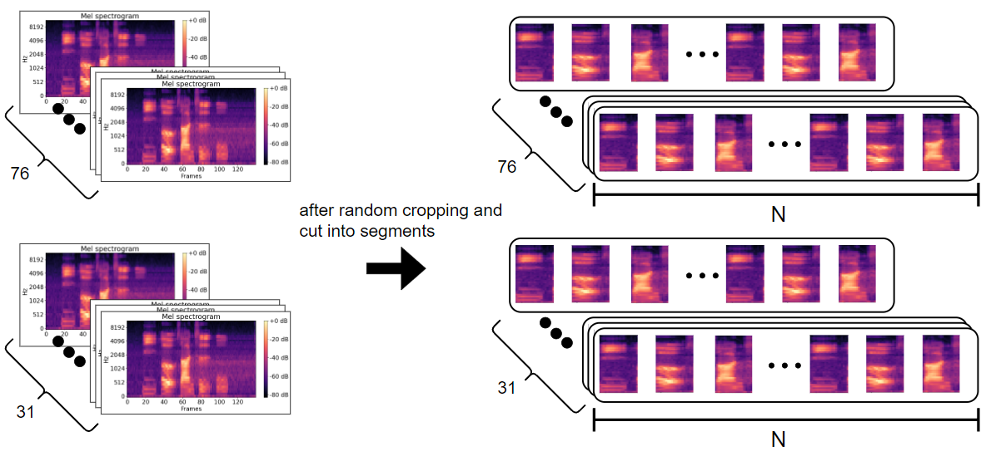
In DAIC-WOZ, there are 107 participant's interview audio files in training set, among all files, there are 76 files labeled as non-depression, 31 files labeled as depression
Notes:
一般 learning rate 都會根據 batch size 做一些 scale 的操作。這裏用的是lr x batch_size / 256」。
Learning rate 小 under-fitting
Learning rate 大 unstable

Slide 6
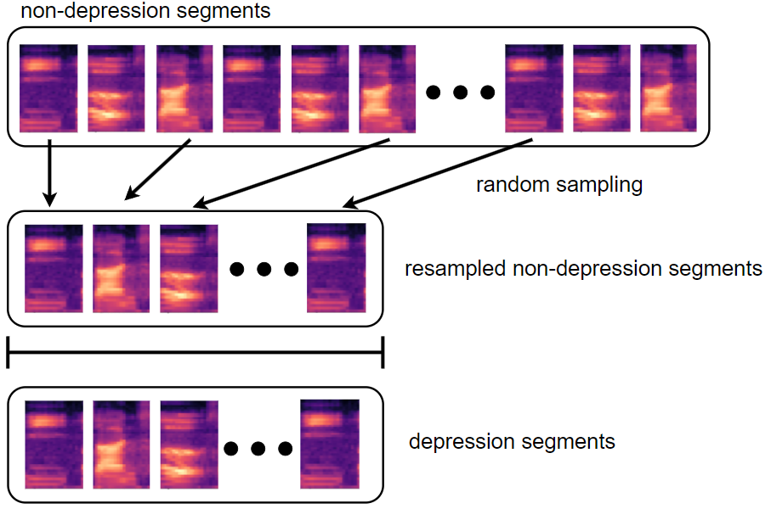
4. subsample the non-depression segments to match the same quantity as depression segments
Notes:
一般 learning rate 都會根據 batch size 做一些 scale 的操作。這裏用的是lr x batch_size / 256」。
Learning rate 小 under-fitting
Learning rate 大 unstable

Slide 7
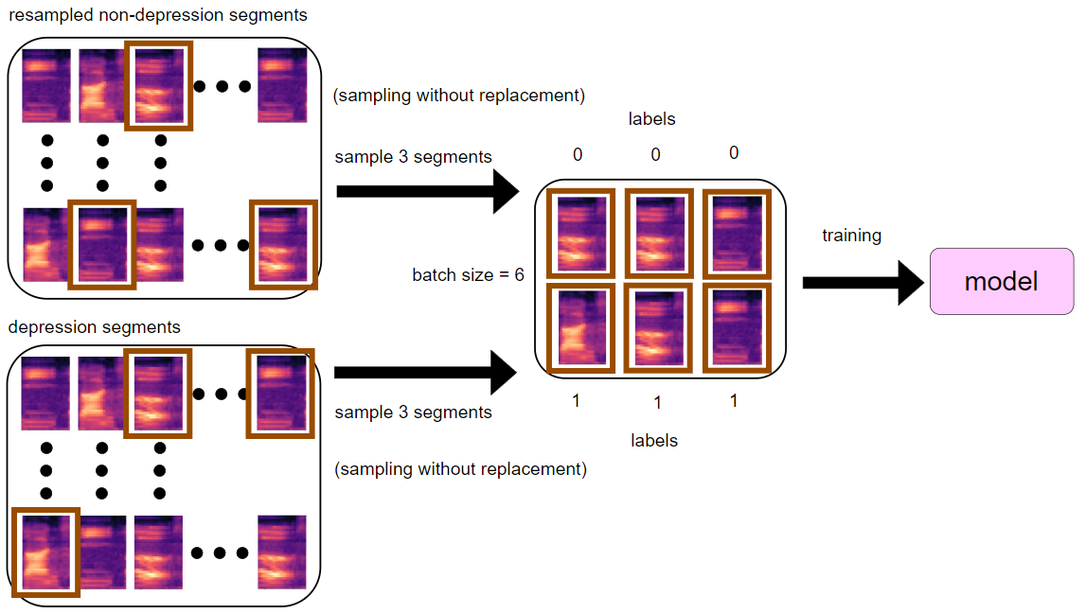
5. During training, extract same quantity of non-depression and depression segments to form a batch
Notes:
一般 learning rate 都會根據 batch size 做一些 scale 的操作。這裏用的是lr x batch_size / 256」。
Learning rate 小 under-fitting
Learning rate 大 unstable

